Slide 1

Ensemble Methods – Part 1
Data Mining– Finals Week 1
Humaira Anzum Neha
Lecturer
Dept of CSE, UIU
humaira@cse.uiu.ac.bd

Slide 2

Ensemble Methods
Ensemble Methods Intuition?
Types of Ensemble Methods
Voting Ensemble
Bagging
Random Forest

Slide 3
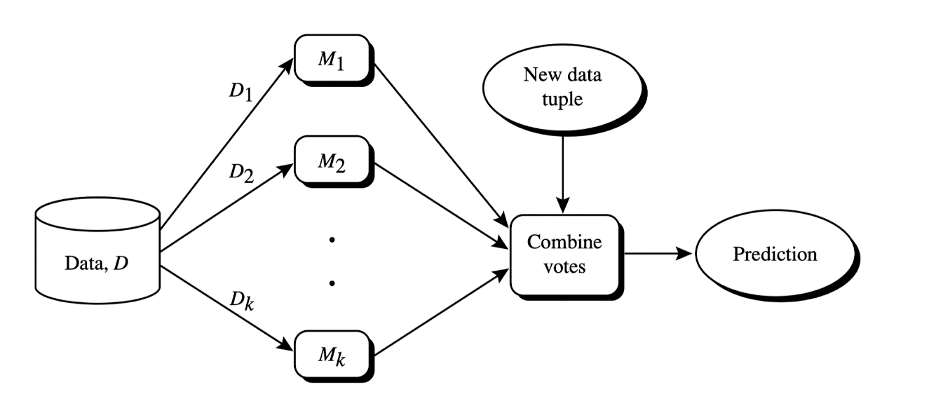
What is Ensemble?
Group / Collection
In Machine Learning, Ensemble signifies a collection of models.
Ensemble methods
  Use a combination of models to increase accuracy
  Combine a series of k learned models, M1, M2, …, Mk, with the aim of creating an improved model M*

Slide 4
Analogy
Wisdom of the crowd
  Collective judgment or decision of a large group of people often more accurate or better than any individual within the group.
  Diversity of opinions, independent thinking, and the aggregation of individual knowledge into a single collective decision.
  Works when much diversity and accuracy.
Democracy (Majority Voting)
Real Incident: Estimating the Weight of an Ox
  Francis Galton at a livestock exhibition once asked people to guess the weight of an ox. Every individual guessed randomly. However the average of all the guesses was remarkably close to the actual weight!

Slide 5
Requirements to generate an improved model
Case 1
  Observations
      Diversity: The models (M1, M2, M3) show diversity in their predictions. For each input (x1, x2, x3), at least one model predicts differently from the others.
      Moderate Accuracy
      Outcome: Positive Effect (The diversity among the models allows the ensemble to correct individual errors)
Input | Model 1 (M1) | Model 2 (M2) | Model 3 (M3) | Voting Ensemble
x1 | ✓ | ✗ | ✓ | ✓
x2 | ✓ | ✓ | ✗ | ✓
x3 | ✗ | ✓ | ✓ | ✓
Notes:
In the context of ensemble learning, individual errors refer to the mistakes or incorrect predictions made by individual models (M1, M2, M3) on certain inputs. These errors can occur because each model may have a different approach, algorithm, or training, which makes them perform differently on the same data points.
For example, in Case 1 :
Model 1 (M1) predicts correctly for x1 and x2 but incorrectly for x3.
Model 2 (M2) predicts correctly for x2 and x3 but incorrectly for x1.
Model 3 (M3) predicts correctly for x1 and x3 but incorrectly for x2.
Each model has some individual errors (wrong predictions), but the voting ensemble combines the predictions of all models and using the variety of outputs from different models ensemble makes better final predictions and reduce overall errors, making the ensemble more accurate than any single model alone.. Since different models make errors on different inputs, the ensemble can often correct those mistakes by "voting" for the majority correct prediction.
Example of Correcting Individual Errors:
For x1: M1 and M3 predict correctly (✓), while M2 predicts incorrectly (✗). The voting ensemble looks at the majority and predicts correctly (✓).
For x2: M1 and M2 predict correctly (✓), but M3 predicts incorrectly (✗). The ensemble predicts correctly (✓) because the majority is correct.
For x3: M2 and M3 predict correctly (✓), while M1 predicts incorrectly (✗). The ensemble again predicts correctly (✓) based on the majority.
In this way, the diversity among the models allows the ensemble to overcome the individual errors made by any single model, leading to more reliable predictions overall.

Slide 6

Requirements to generate an improved model
Case 2
  Observations
      No Diversity: All three models (M1, M2, M3) are making the exact same predictions for all inputs (x1, x2, x3). Model structure identical
      High Accuracy
      Outcome: No Effect (No need to ensemble)
Input | Model 1 (M1) | Model 2 (M2) | Model 3 (M3) | Voting Ensemble
x1 | ✓ | ✓ | ✓ | ✓
x2 | ✓ | ✓ | ✓ | ✓
x3 | ✗ | ✗ | ✗ | ✗

Slide 7
Requirements to generate an improved model
Case 3
  Observations
      Diversity: The models (M1, M2, M3) show high diversity in their predictions for each input. Each model predicts differently for every case.
      Low Accuracy
      Outcome: Negative Effect, the ensemble method (majority voting) results in incorrect predictions for all inputs (x1, x2, x3). The diversity is high, but since each model's prediction is incorrect.
      Error Propagation: If all models have significant errors or if their predictions do not complement each other effectively, the ensemble’s performance can degrade, showing that diversity alone is not enough; models also need to be reasonably accurate.
Input | Model 1 (M1) | Model 2 (M2) | Model 3 (M3) | Voting Ensemble
x1 | ✓ | ✗ | ✗ | ✗
x2 | ✗ | ✓ | ✗ | ✗
x3 | ✗ | ✗ | ✓ | ✗

Slide 8
Requirements to generate an improved model
Takeaways
  Positive Effect: When models are diverse and individually accurate, the ensemble can correct errors and improve overall performance.
  No Effect: When models are too similar (lack diversity) and already highly accurate, the ensemble adds little value, resulting in no significant improvement.
  Negative Effect: When an ensemble includes a model with low accuracy, even if other models are diverse, the overall performance can suffer, leading to a decline in accuracy.

Slide 9
Requirements to generate an improved model
What are the requirements to achieve an improved model?
  Base models should be
    Accurate
    Diverse
How to introduce diversity among models?
  By using Different Algorithms
  Same Algorithms but training the models on different subsets of data.
  Combination of both

Slide 10
Ensemble Learning
Prediction phase of ensemble learning
  For classification problem : Majority Count
  For example, if three models predict a binary classification (e.g., Class A or Class B) and two models predict Class A while one predicts Class B, the ensemble will output Class A (the majority prediction).
  For Regression Problem : Average
  For example, if three models predict values 5.2, 5.8, and 6.0, the ensemble would output the average of these predictions: 5.2+5.8+6.0/3=5.67
Notes:
Classification problems use majority voting (selecting the most frequent prediction).
Regression problems use averaging (taking the mean of predictions).

Slide 11
Types of Ensemble Learning
Voting Ensemble
Bagging
  Random Forest
Boosting
  Adaboost
  Gradient Boosting
  XgBoost

Slide 12
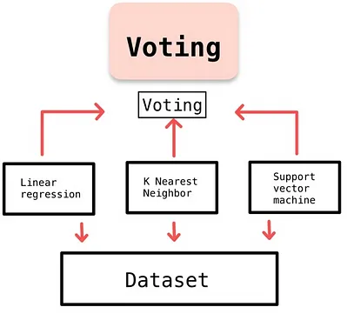
Voting Ensemble
Base Models: Different Algorithms but trained with the same dataset
Prediction
  For classification: Majority Voting
  For regression : Average

Slide 13

Why Voting Works?
Requirements
  All the base models should be independent. High diversity
  Minimum Accuracy of each individual model should be 50%.
Let's walk through an example of how it actually works. (Follow class Lecture)
Accuracy: 70% 70% 70% = 0.7
What is the observation?
What happens if each model has accuracy 30%?
M1
M2
M3
Notes:
What is the observation?
This might be asking you to notice that even though each individual model has a 70% accuracy, their combined decision through voting can result in better overall accuracy than any one model alone.
What happens if each model has an accuracy of 30%?
If each model has an accuracy lower than 50%, the ensemble will likely perform poorly because the models are more likely to make incorrect predictions. If the models are consistently wrong, voting will not improve the accuracy.
The Key Idea:
Voting works because when models are diverse (independent) and individually accurate (greater than 50%), combining their predictions through majority voting can lead to better results. This is because the models can "cover" for each other's mistakes, and the ensemble tends to correct individual errors by choosing the majority prediction.

Slide 14
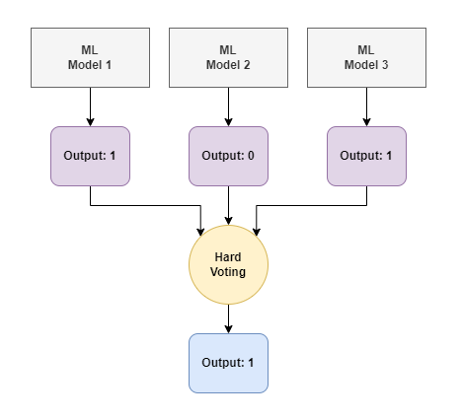
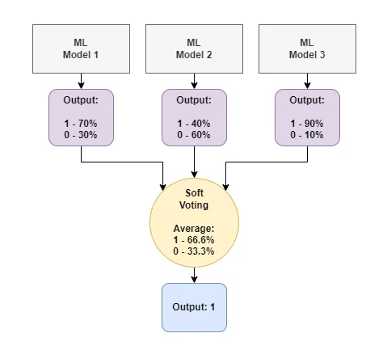
Hard Voting vs Soft Voting
Notes:
Hard Voting:
Each individual model (ML Model 1, ML Model 2, ML Model 3) makes a prediction, either 0 or 1 (for a binary classification problem).
In hard voting, the final prediction is determined by majority voting. The class with the most votes is selected as the ensemble’s output.
In the example:
ML Model 1 predicts 1.
ML Model 2 predicts 0.
ML Model 3 predicts 1.
The majority prediction is 1 (since 2 out of 3 models predict 1), so the final output is 1.
2. Soft Voting:
In soft voting, each model gives a probability score for each class (instead of just making a hard prediction). These probabilities are averaged, and the class with the highest average probability is chosen.
In the example:
ML Model 1 predicts a probability of 70% for class 1 (and 30% for class 0).
ML Model 2 predicts a probability of 40% for class 1 (and 60% for class 0).
ML Model 3 predicts a probability of 90% for class 1 (and 10% for class 0).
To get the final output, the average probabilities are calculated:
For class 1: 70%+40%+90%/3=66.6%
For class 0: 30%+60%+10%./3=33.3%
Since class 1 has the higher average probability (66.6% vs. 33.3%), the final output is 1.
Summary:
Hard Voting: Counts the majority of votes (discrete decisions). It’s simple but doesn't consider confidence in predictions.
Soft Voting: Averages the probabilities predicted by each model. This method can be more accurate since it takes into account how confident each model is in its prediction.

Slide 15
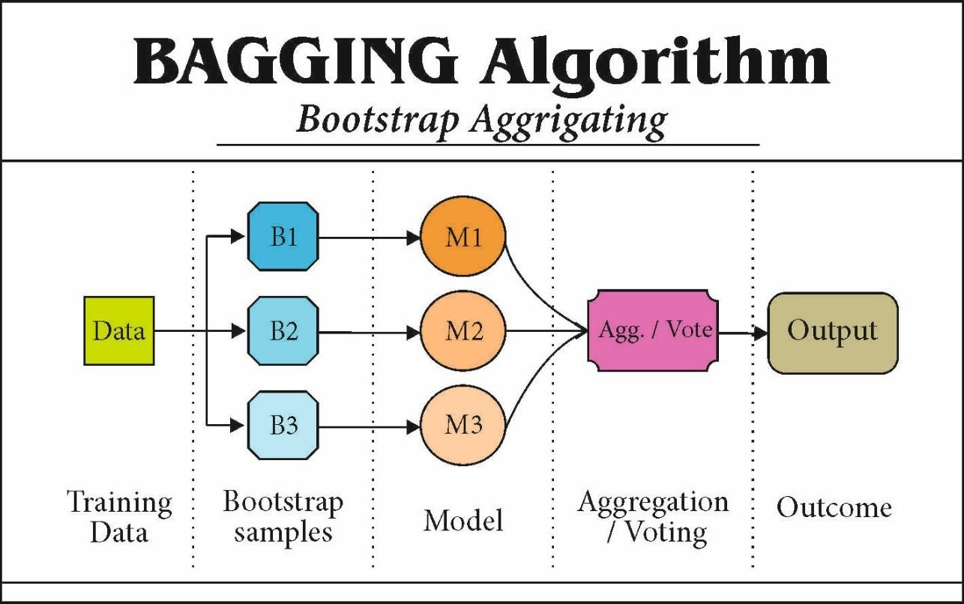
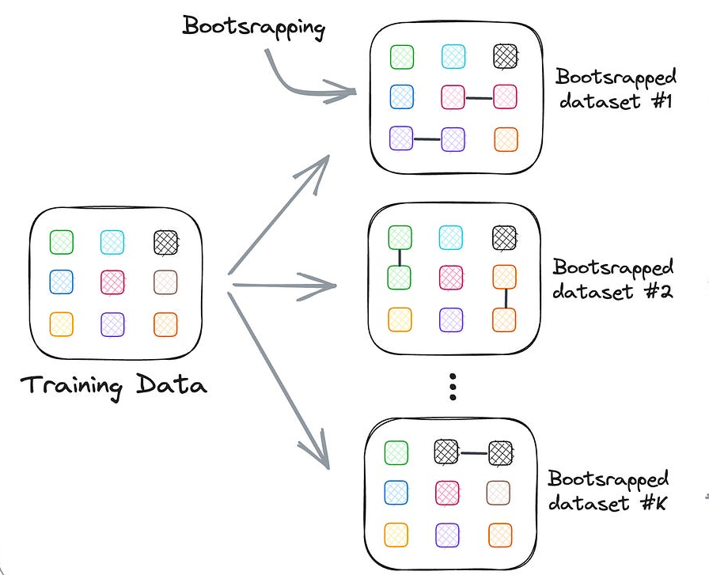
Bagging (Bootstrap Algorithm)
Base Models: Same
Dataset: Bootstrap Sampling - Randomly selecting samples from the original dataset with replacement
Notes:
Key Concepts of Bagging:
Base Models: Same
In bagging, we use multiple versions of the same model type, but each model is trained on different subsets of the data.
Bootstrap Sampling (Random Sampling with Replacement)
To create diversity, bagging uses a method called bootstrap sampling. This means:
From the original training dataset, we randomly select data points with replacement.
With replacement means that a data point can be selected more than once, so each subset (or bootstrap sample) can contain duplicates.
This creates several different bootstrap samples, which are used to train each individual model.
How Bagging Works:
Step 1: Bootstrap Sampling:
The original training data is used to create multiple bootstrapped samples (e.g., B1, B2, B3).
Step 2: Train Models:
Each bootstrap sample is used to train a separate model (e.g., M1, M2, M3), but the model type remains the same for all.
Step 3: Aggregation:
After training, the outputs from each model are combined using voting (for classification) or averaging (for regression). This gives the final prediction or output.
Why Bagging Works:
Reduces Overfitting: Since each model is trained on a different subset of the data, bagging reduces the chance that the models will overfit (i.e., memorize the data instead of generalizing well).
Improves Accuracy: By aggregating the predictions of multiple models, bagging tends to produce better overall results compared to just using one model trained on the full dataset.
Visual Summary:
The left side shows the process of taking bootstrap samples (B1, B2, B3) from the original data, training models (M1, M2, M3), and aggregating the results through voting.
The right side illustrates the process of creating different bootstrapped datasets from the original training data.

Slide 16
Bagging (Bootstrap Algorithm)
Training
  For i = 1 to k
    create bootstrap sample, D_{i}, by sampling D with replacement;
    use D_{i} and the learning scheme to derive a model, M_{i} ;
Classification: classify an unknown sample X
  let each of the k models classify X and return the majority vote
Prediction:
  To predict continuous variables, use average prediction instead of vote

Slide 17
Bias-Variance tradeoff
Bias
- The inability of the model to truly capture the relationship in the training data .
So , if a model can not perform well on the training data, then the model is highly biased.
Variance
- Measure of the change in the model’s predictions when trained on different subsets of the data.
For say training error is 10.
But the testing error is 100.
So, Variance is high.
Notes:
What is Bias?
Bias is when a model is too simple to understand the underlying patterns in the data.
Imagine you are trying to predict house prices based only on the number of bedrooms, ignoring other factors like location, size, and condition of the house. Since you're missing out on important details, your model is too simplistic. This is called high bias.
A model with high bias will underfit, meaning it will perform poorly both on the training data (the data used to train it) and on new unseen data (testing data). It just doesn't capture the real complexity of the problem.
Example: If you train a very simple model, like a straight line (linear regression), to predict complex patterns, you might get a model that makes a lot of mistakes because it's too simple. That's high bias.
What is Variance?
Variance is when a model is too focused on the training data, so it doesn't generalize well to new, unseen data.
If you make a model too complex (for example, using a model that tries to follow every single detail in the training data), it might perform well during training but fail when tested on new data. This happens because the model has "memorized" the training data, rather than learning the general patterns.
A model with high variance will overfit, meaning it performs very well on the training data but makes a lot of mistakes when used on new data.
Example: If you train a model with too many layers or too many complex features, it might perfectly match the training data but perform poorly on unseen data. That's high variance.
The Tradeoff
The Bias-Variance Tradeoff is about finding the right balance between a model being too simple (high bias) and too complex (high variance).
High bias: Model is too simple, underfits, and makes errors on both training and testing data.
High variance: Model is too complex, overfits the training data, and performs poorly on new data.
What we want is a model with:
Low bias: So that it can capture the complexity of the data.
Low variance: So that it can generalize well to new, unseen data.
Easy Example:
Imagine you’re preparing for an exam:
High bias: You just study one topic in a simple way, ignoring other possible topics. On exam day, you don’t perform well because the test covers much more than what you studied.
High variance: You study all the tiny details from old exams, but when the exam questions change even a little bit, you get confused because you memorized the specifics and not the general concepts.
Visualizing the Tradeoff:
Low Bias, High Variance: Your model knows a lot about the training data (memorized it) but fails when the test changes (overfit).
High Bias, Low Variance: Your model is too simple to perform well on the training data and also fails on new data (underfit).
Goal:
We want to find the sweet spot where the model is just complex enough to learn from the training data without overfitting or underfitting. This balanced point gives low bias and low variance.

Slide 18
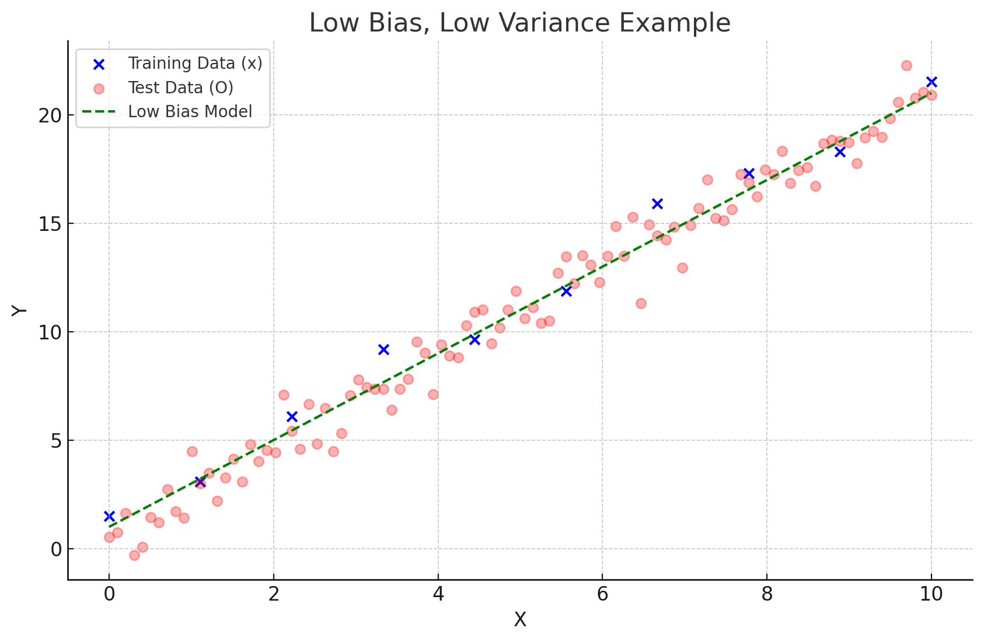
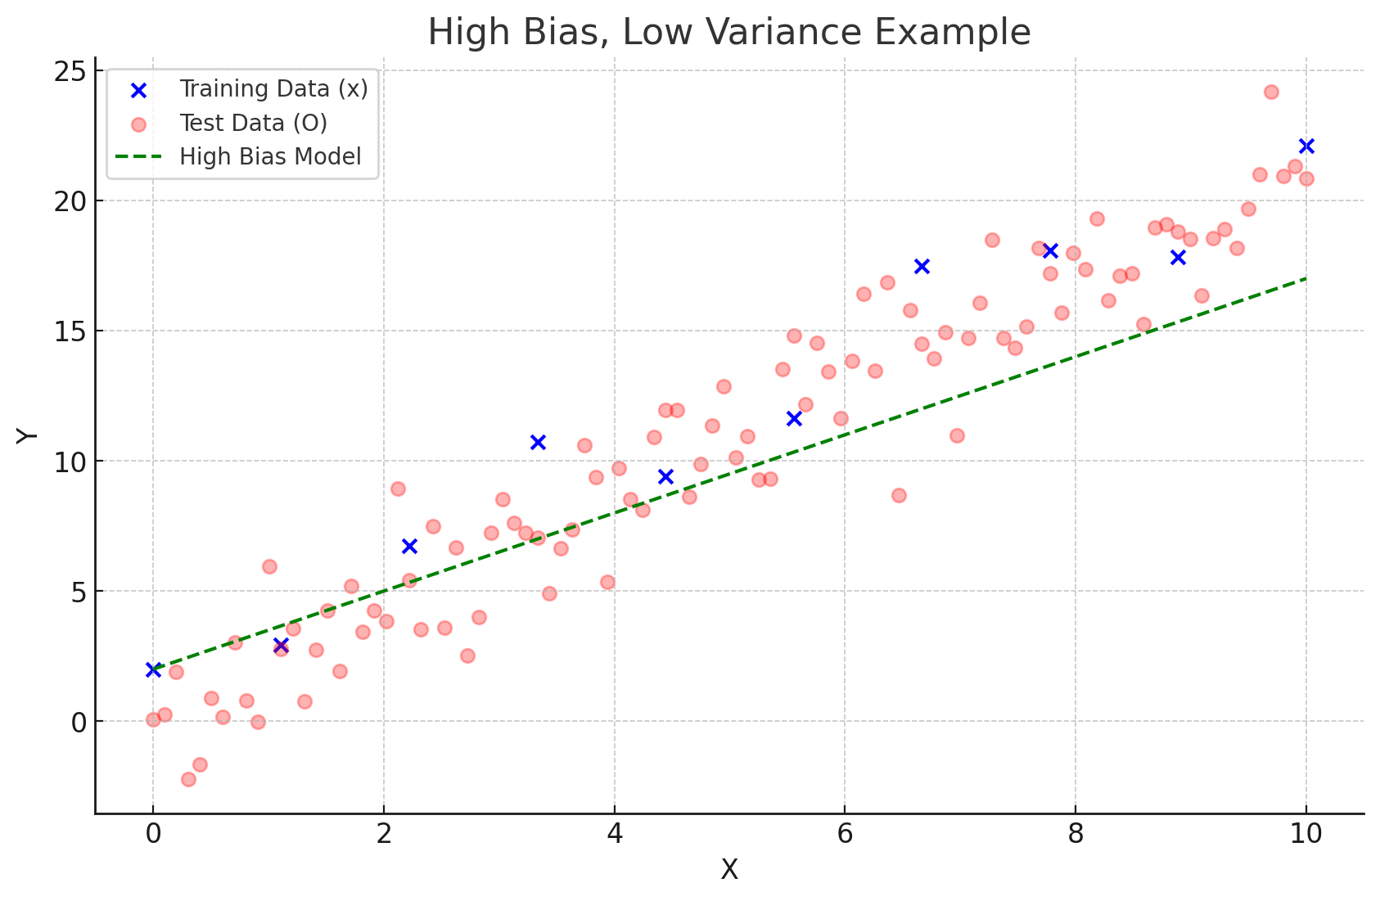
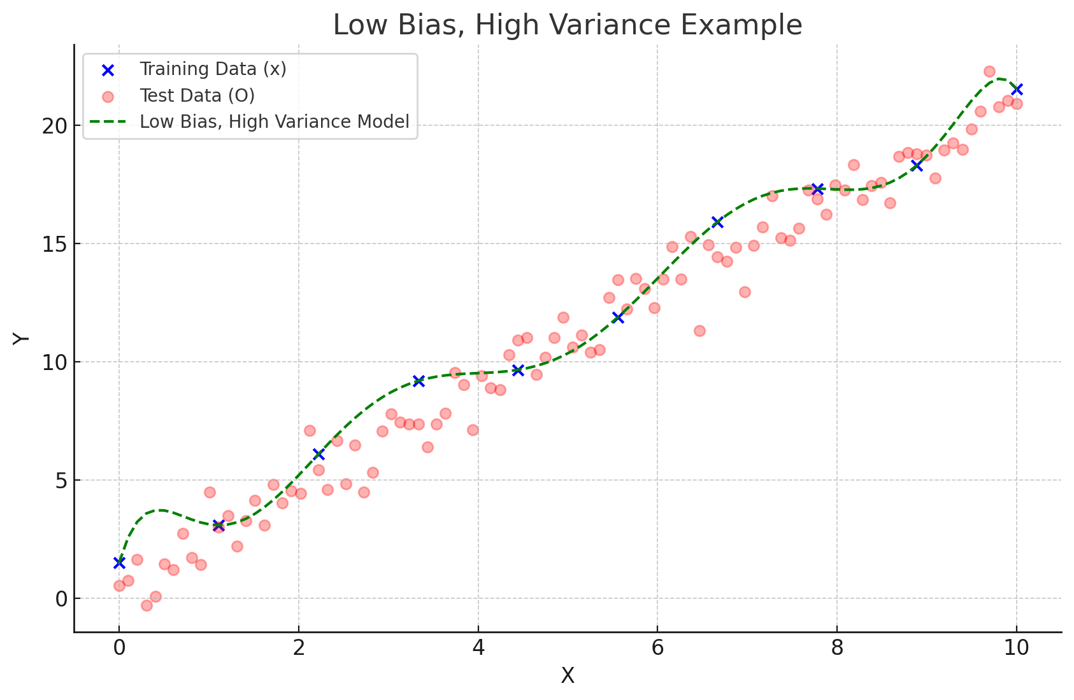
Bias-Variance tradeoff

Slide 19
Bias-Variance tradeoff
Overfitting:
  Too complex model
  Performs too well for training data (Low Bias)
  But can not perform well for test data (High Variance)
Underfitting
  Too simple model
  Can not perform well in training data. (High Bias)
Our target is to develop an optimal model.
Balanced (Low) Bias
Balanced (Low ) Variance.

Slide 20
Why Bagging?
Bagging reduces the variances in model’s prediction.
In Bagging , we take algorithms that have low bias, high variance. Ex. Decision Tree, Support Vector Machine, KNN . These algorithms are prone to overfitting. So , our target is to reduce the variance.
The impact of the data change gets divided among the models. So, shows less change in the behavior resulting in low variance.
Notes:
What is Bagging?
Bagging is a technique used in machine learning to reduce the variance of a model, meaning it helps prevent overfitting. Overfitting occurs when a model learns too much from the training data, capturing not only the general patterns but also the noise (randomness) in the data, which can make it perform poorly on new, unseen data.
Why Use Bagging?
Bagging is used to tackle high variance models. High variance models are complex models that tend to overfit the training data. Common examples of high variance models include:
Decision Trees
Support Vector Machines (SVM)
k-Nearest Neighbors (KNN)
These models usually have low bias (meaning they can capture the patterns in the data well), but they are prone to overfitting, so they tend to have high variance. Bagging aims to reduce the variance of these models, making them perform better on unseen data.
How Bagging Works:
Multiple Models: In Bagging, we train multiple versions of the same model (e.g., multiple decision trees) on different random subsets of the training data.
Aggregation: After training, we combine the predictions from all these models to get the final prediction (for classification, this is often done by voting; for regression, it's by averaging the predictions).
Impact: Each data point only affects some of the models, not all. So, when we combine the models, the final result is more stable and doesn't change too much. This helps the model work better on new data and avoids overfitting.
Example to Understand:
Imagine you are asking multiple friends for advice on where to eat dinner. Each friend has their own opinion (representing a different model trained on a different subset of data). If you go with the majority vote (aggregating their opinions), your decision will be less affected by any one friend's extreme preference, and you'll likely make a better overall decision.
Key Takeaways:
Bagging reduces variance by averaging the results of many models, which reduces overfitting.
It works well on models that are prone to high variance, like Decision Trees and KNN.
By dividing the data's impact across multiple models, the final model shows less change in behavior when the data changes, meaning it generalizes better to new data.
Real-world Use of Bagging:
A popular implementation of Bagging is Random Forest, where multiple decision trees are trained on different parts of the data, and the results are combined to improve accuracy and stability.

Slide 21
Types of Bagging
Based on how the subsets of data are being created.
Row sampling
Column/Feature/Attribute sampling
Combination of both (Row and Feature)
Pasting- Row sampling but without replacement

Slide 22
Random Forest
Bagging with Decision Trees as base models.
Random (Bagging -Random sampling of data) Forest (Collection of trees)
Random Forest allows for more diversity. Extra randomness .
Step 1
  Base estimators -> Decision Tree
Step 2
  Sampling
• Row Sampling ( Randomly select rows with replacement for each tree) or
• Feature Sampling (At each node randomly select some attributes or features as candidates and then split by the best attribute among them)
Step 3
  Classification
    Majority voting
Notes:
Step 1:
Base Estimators -> Decision Trees
Base Estimators: These are the basic models that will be used in Bagging or Random Forest. In this case, the base model is a Decision Tree.
A Decision Tree is a type of model that makes decisions by splitting the data based on features (for example, splitting data by age or salary range) until it can make a final decision (like classifying something as "yes" or "no").
Step 2:
Sampling
Sampling is the key part of Bagging or Random Forests. It involves creating multiple versions of the training data by randomly selecting subsets of data.
Row Sampling (Bootstrapping):
Here, we randomly select rows (examples from the dataset) to create different training sets for each tree. Some data points might appear more than once, and some might not appear at all. This is called sampling with replacement.
Think of it like randomly picking students from a class to form study groups. Some students might be in more than one group, while some may not be picked in a particular group.
Feature Sampling (Used in Random Forests):
At each decision point in the tree (each "node"), instead of looking at all possible features (age, salary, etc.), we randomly pick a few features to decide the best split.
This adds randomness to the model, making the final result more robust by reducing overfitting.
Step 3:
Classification -> Majority Voting
Once we’ve trained multiple decision trees (each on a different subset of the data), we need to combine their predictions.
For classification tasks (where the output is a label, like "spam" or "not spam"), we use majority voting.
This means each tree gives a prediction, and the final result is the one that gets the most votes from all the trees.
For example, if 3 out of 5 trees say “spam” and 2 say “not spam,” the final decision will be “spam” because it has the majority vote.
Summary:
Step 1: Start with multiple Decision Trees as base models.
Step 2: Use random sampling to create different training sets and build trees on these. You can either sample rows (data points) or features (variables) to make each tree a little different.
Step 3: Once all the trees are built, we combine their predictions. For classification, we use majority voting to decide the final result.
This process is key to improving the performance and stability of models like Random Forests.

Slide 23
Random Forest
Bagging with Decision Trees as base models.
Random (Bagging -Random sampling of data) Forest (Collection of trees)
Random Forest allows for more diversity. Extra randomness .
Step 1
  Base estimators -> Decision Tree
Step 2
  Sampling
• Row Sampling ( Randomly select rows with replacement for each tree) or
• Feature Sampling (At each node randomly select some attributes or features as candidates and then split by the best attribute among them)
Step 3
  Classification
    Majority voting
Notes:
Instead of training a single model with all available features, feature bagging involves training multiple models (like decision trees) using random subsets of features.
Each model is trained on a different subset of features, meaning each tree sees a slightly different view of the data.
The models trained on feature subsets will each learn different patterns, some of which may complement or correct each other.
During prediction, the outputs from multiple models are combined (e.g., by averaging in regression or voting in classification). This ensemble approach helps reduce the variance and avoids reliance on any single, possibly overfitted model.
Even if individual models are overfitted to their specific feature subsets, their combined prediction is more robust and generalizable.

Slide 24
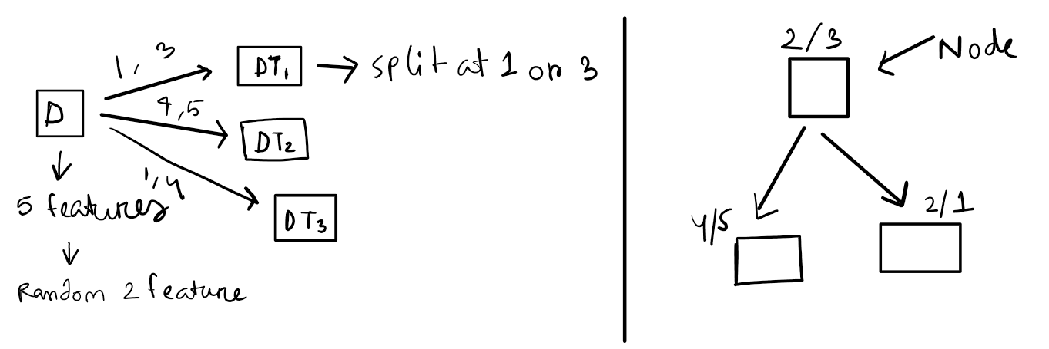
Bagging vs Random Forest
In bagging . Base estimators could be DT, SVM, KNN etc. In RF, base model can only be Decision Tree.
The way of feature sampling is different for both of them. In bagging , Feature sampling is done in tree level. For each tree random selection of attributes is done.
In RF, Feature sampling done in node level. At each node before splitting column sampling is done.
Notes:
Here, (1,3),(4,5),(1,4) are data.

Slide 25
Random Forest
Two Methods to construct Random Forest:
  Forest-RI (random input selection): Randomly select, at each node, F attributes as candidates for the split of data at the node.
  Forest-RC (random linear combinations): Creates new attributes (or features) that are a linear combination of the existing attributes (reduces the correlation between individual classifiers) .For example, if the original features are x1,x2,…,xN, a new feature might be created as:
z=α1x1 + α2x2 +⋯+ αNxN
Here, α1, α2, …, αN are randomly chosen coefficients. A subset of these new features (random linear combinations) is selected at each node, similar to the Forest-RI method

Slide 26
Visualization
  https://bootstrap-aggregation-bagging.streamlit.app/
  https://votingclassifier.streamlit.app/
  https://github.com/campusx-official/bagging-ensemble/blob/main/bagging-learning-tool.ipynb

